Slide 1

The Financing of Local Government in China: stimulus loan wanes and shadow banking waxes
Zhiguo He (何治国)
University of Chicago, Booth School of Business; and NBER
joint with Zhuo Chen (Tsinghua PBCSF) and Chun Liu (Tsinghua SEM)

Slide 2
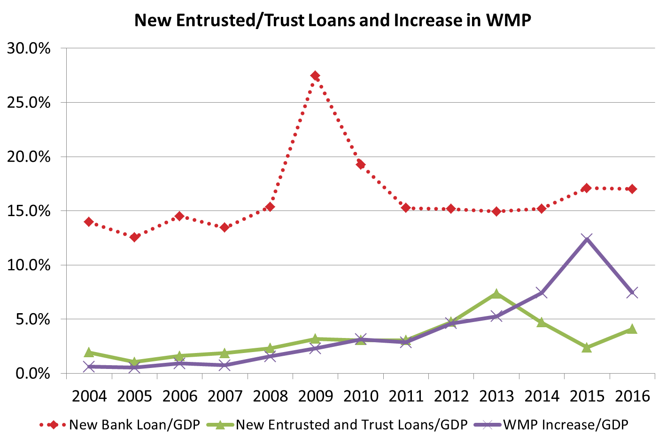
Motivation
Trust/Entrusted loans : 信托和委托贷款; WMP: 理财产品
Data source: PBOC and China Banking Wealth Management Registration System

Slide 3
New bank loan & GDP
Data source: PBOC and National Bureau of Statistics

Slide 4
US-China bond markets
Bond/GDP~85%
Bond/GDP~200%

Slide 5
Summary
China’s local government debt shifts from bank loans in 2009 to a significant fraction of non-bank debt starting 2012
This paper: The real force behind the upsurge of shadow banking
  A universal economic phenomenon/mechanism
Why do shadow banking activities in China start rampant growth around 2012-13?
  Hangover effect of 2009 stimulus
  Time series and cross-section evidence on local government financing and municipal corporate bonds (城投债)
  An angle that helps understand the marketization process of Chinese financial system starting 2012

Slide 6
Four-Trillion Stimulus Plan and its financing
Four-trillion Stimulus plan (四万亿刺激计划)
  Following 2007/08 global crisis, Premier Wen announced the 4T RMB stimulus plan on Nov 2008
  Domestic investment (mainly infrastructure) to boost GDP growth
How was it implemented and financed?
  Mostly through local governments (Bai, Hsieh and Song, 2016, Brookings)
  1 trillion from Beijing; the rest through LGFV (Local Government Financing Vehicles, 政府融资平台)
  Mostly in the form of bank loans (90% commercial bank loans and 10% policy bank loans)

Slide 7
Four-Trillion Stimulus Plan and its financing
Transfer of 1 Trillion RMB
Local Government
Beijing, central govt
1994 Budget law
Equity holder, by injecting land
Commercial Banking system
Local Government Financing Vehicle
(Local State-Owned Enterprises)
Loans of 2.7 Trillion RMB
Households deposits
Loans of 0.3 Trillion RMB
Policy Banks

Slide 8
Shifting of local government financing (1)
in 2010 China reverted back to its normal credit policy…
2009 Stimulus loan hangover effect
  Need to rollover/refinance their three- to five-year bank loans (which are maturing around 2012 to 2014)
  Long-term infrastructure projects need continuing investment
LGFVs turn to non-bank sources
  What are they?

Slide 9
Shifting of local government financing (2)
four major debt liabilities
  Bank Loans
  Municipal Bonds (地方政府债: pre-2015, issued directly by MoF for qualified local government; post-2015, issued by local government at the province level)
  Municipal Corporate Bonds (城投债, our focus)
    Corporate bonds issued by LGFVs
  Trust and Entrusted Loans (信托贷款和委托贷款)
other three are non-bank debt; often with implicit bail-out expectation
National Audit office reports on local government debt, on Dec 2010 and June 2013
  Worked hard filling out the rest
  Bank loan wanes, non-bank debt waxes

Slide 10
Composition change of bank and non-bank debt financing

Slide 11
Municipal corporate Bond（MCB, 城投债）
Data source: PBOC and Wind

Slide 12
Cross-sectional analyses: Evidence from MCB
Core idea
  Areas/provinces with more bank-loan-fueled stimulus in 2009 should have more shadow banking in 2012-2015
    Matters little whether driven by LGFVs (demand) or banks (supply) in 2009
      Though, we use “late-term officials” as IV (demand shifter) to address other endogeneity concerns
We focus on Municipal corporate Bonds
  It is more than data availability issue; source of fund versus use of fund
  For MCB, we know where the funds go to

Slide 13
Preliminary Evidence
Economic variables
  Abnormal 2009 Bank loan over GDP at the province level
    (BL/GDP at 2009) – (Average BL/GDP 2004~08)
  Abnormal 201t MCB over GDP for each province over 2012-2015
    (MCB/GDP at 201t) – (Average MCB/GDP 2004~08)
We also look at regional and city level

Slide 14
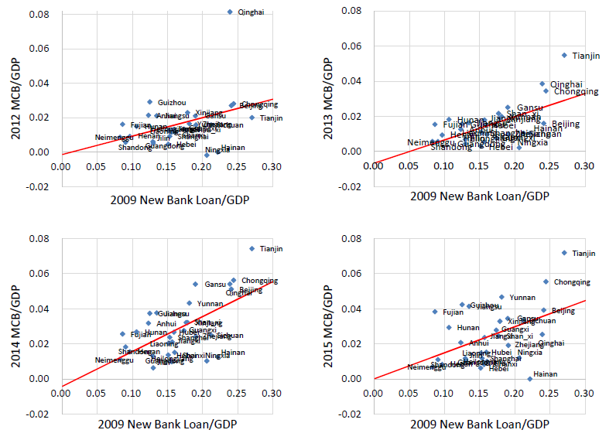
Provincial evidence for each year, 2012-2015

Slide 15


Main empirical tests
empirical specification
  Province FE ($α_{i}$) and year FE ($α_{t}$); from 2004 to 2015
  Time-varying impacts of 2009 abnormal BL on future MCB issuances
    Controls with flexible time coefficients: economic activity at 2007Q4-2008Q3
    Fiscal deficit over GDP, fixed asset investment over GDP; GDP growth, GDP per capita
  Instrument variable: whether a provincial governor is “late term” (>2 years in the position) as of 2009
    Stronger promotion incentive for “late-term” governor to react to the stimulus
    More familiar with the local environment, easier to implement the stimulus
Other evidences
  The effect of longer-term CDB loans, city level results
  Control variables at the same year for omitted variables
  Real effects

Slide 16
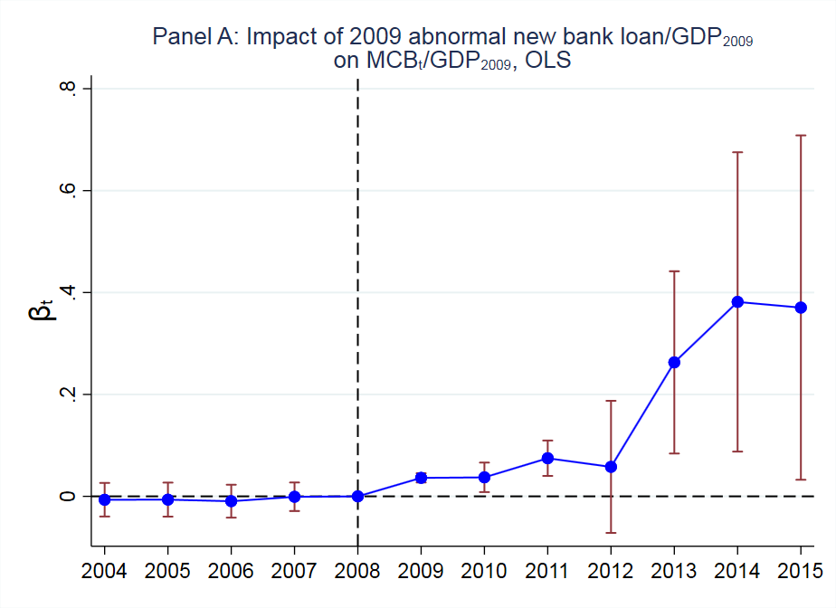
OLS result
Throughout, standard errors clustered at province-year level

Slide 17
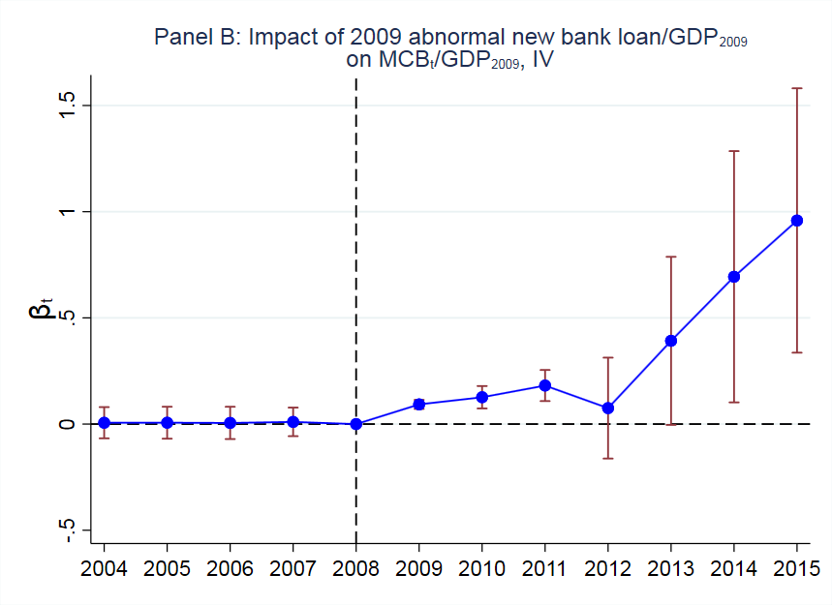
iv result

Slide 18
MCB issuance purposes
81% of MCB prospectus reveal its purpose…. but self-reporting

Slide 19
Estimation results
 | MCB |  |  | MCB_repay |  |  | MCB_inv
 | OLS | 2SLS |  | OLS | 2SLS |  | OLS | 2SLS
2004 | -0.007 | 0.006 |  | -0.001 | -0.001 |  | -0.006 | 0.005
 | (0.017) | (0.038) |  | (0.005) | (0.011) |  | (0.009) | (0.017)
2005 | -0.006 | 0.006 |  | -0.001 | -0.001 |  | -0.006 | 0.005
 | (0.017) | (0.038) |  | (0.005) | (0.011) |  | (0.009) | (0.018)
2006 | -0.009 | 0.005 |  | -0.001 | -0.001 |  | -0.009 | 0.005
 | (0.016) | (0.039) |  | (0.005) | (0.011) |  | (0.008) | (0.018)
2007 | -0.001 | 0.010 |  | -0.001 | -0.001 |  | 0.003 | 0.017
 | (0.014) | (0.034) |  | (0.005) | (0.011) |  | (0.006) | (0.014)
2009 | 0.036*** | 0.093*** |  | 0.002 | 0.001 |  | 0.030*** | 0.079***
 | (0.005) | (0.011) |  | (0.004) | (0.010) |  | (0.007) | (0.022)
2010 | 0.037** | 0.126*** |  | 0.009 | 0.019*** |  | 0.022* | 0.077***
 | (0.015) | (0.027) |  | (0.006) | (0.007) |  | (0.013) | (0.030)
2011 | 0.075*** | 0.181*** |  | 0.015*** | 0.047*** |  | 0.041*** | 0.060**
 | (0.018) | (0.037) |  | (0.003) | (0.007) |  | (0.007) | (0.024)
2012 | 0.058 | 0.075 |  | 0.020 | 0.012 |  | 0.002 | 0.065
 | (0.066) | (0.121) |  | (0.019) | (0.047) |  | (0.053) | (0.077)
2013 | 0.263*** | 0.392* |  | 0.091*** | 0.120 |  | 0.098*** | 0.162***
 | (0.091) | (0.202) |  | (0.034) | (0.078) |  | (0.030) | (0.054)
2014 | 0.382** | 0.694** |  | 0.12** | 0.201* |  | 0.040 | 0.247***
 | (0.150) | (0.302) |  | (0.049) | (0.114) |  | (0.054) | (0.087)
2015 | 0.37** | 0.958*** |  | 0.187*** | 0.473*** |  | -0.013 | 0.115
 | (0.172) | (0.317) |  | (0.058) | (0.120) |  | (0.057) | (0.071)
Province FE | Yes | Yes |  | Yes | Yes |  | Yes | Yes
Year FE | Yes | Yes |  | Yes | Yes |  | Yes | Yes
Control*Year | Yes | Yes |  | Yes | Yes |  | Yes | Yes
Observations | 360 | 360 |  | 360 | 360 |  | 360 | 360
First stage F |  | 3.803 |  |  | 3.803 |  |  | 3.803
Adj R2 | 0.720 | 0.695 |  | 0.652 | 0.629 |  | 0.671 | 0.665

Slide 20
Economic magnitude
What is the loan maturity implied by estimated coefficients?
In aggregate, each dollar of stimulus loan needs 1.57/4.7 = 33 cents of repayment MCB issuance
  RMB 4.7 trillion abnormal bank loans extended in 2009
  In total, RMB 1.57 trillion worth of MCB was issued to repay bank loans (the rest is repaid by trust)
Cross-sectional regression, how many years do we need to payback 33 cents?
  Just accumulating the estimated coefficients….
  The IV estimate implied stimulus loan maturity is 3.9 years
  Consistent with other sources (3-5 years in Kroeber, 2016; 4.1 years in Ru, 2018)

Slide 21
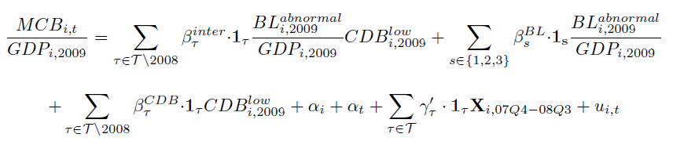

EVIDENCE FROM CDB LOAN
Loans from China development Bank have longer maturity
  CDB: policy bank, tends to give longer maturity loans (7.2 years in Ru, 2018)
rollover mechanism is concentrated in in low-CDB-loan provinces
  Dummy ${CDB}_{i,2009}^{low}$: whether the 2009 CDB loan fraction of a province i is below the median (max 74%, median 16%)
Prediction
  $β_{τ}^{BL}$ which captures the effect on high CDB-loan province should be insignificant
  The coefficients $β_{τ}^{inter}$ in front of the interaction term have similar magnitude as the baseline without CDB interactions

Slide 22
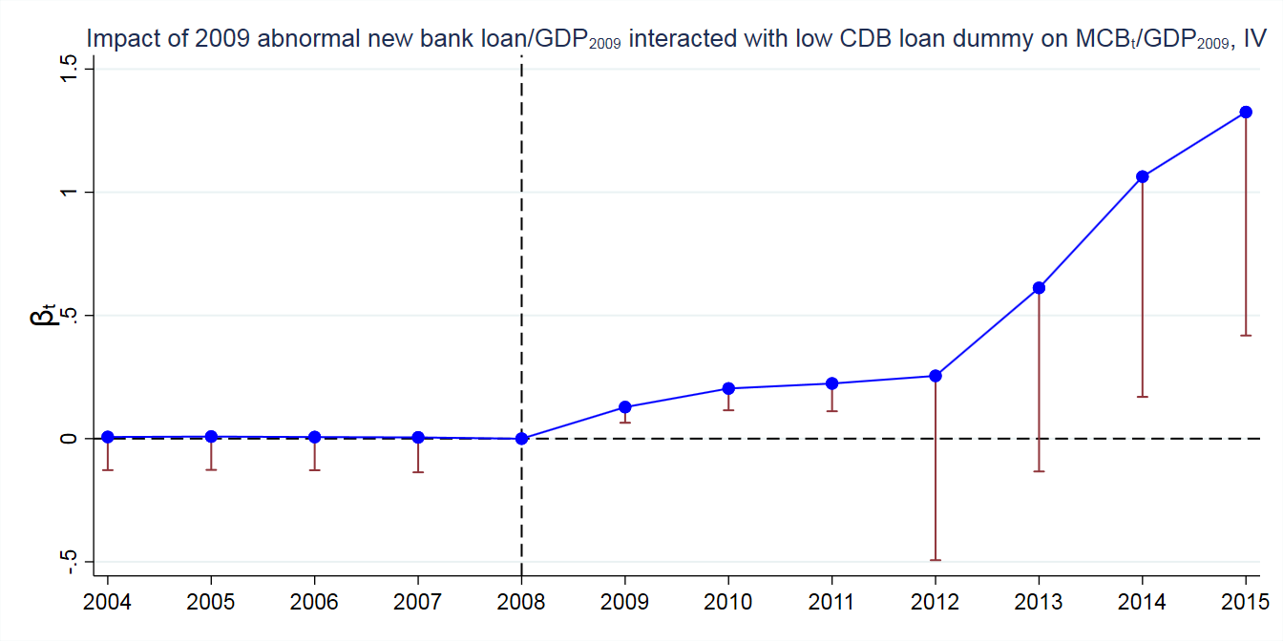
EVIDENCE FROM CDB LOAN

Slide 23
EVIDENCE at city level
 | MCB |  |  | MCB_repay |  |  | MCB_inv
 | OLS | 2SLS |  | OLS | 2SLS |  | OLS | 2SLS
2004 | -0.002 | -0.001 |  | 0.000 | 0.000 |  | -0.002 | 0.000
 | (0.004) | (0.010) |  | (0.000) | (0.000) |  | (0.001) | (0.005)
2005 | -0.001 | 0.000 |  | 0.000 | 0.000 |  | -0.001 | 0.000
 | (0.004) | (0.010) |  | (0.000) | (0.000) |  | (0.002) | (0.005)
2006 | -0.002 | 0.000 |  | 0.000 | 0.000 |  | -0.002 | 0.001
 | (0.004) | (0.010) |  | (0.000) | (0.000) |  | (0.001) | (0.005)
2007 | 0.000 | 0.004 |  | 0.000 | 0.000 |  | 0.000 | 0.005
 | (0.004) | (0.009) |  | (0.000) | (0.000) |  | (0.001) | (0.004)
2009 | 0.005* | 0.032*** |  | 0.000 | 0.000 |  | 0.005*** | 0.028***
 | (0.003) | (0.003) |  | (0.001) | (0.003) |  | (0.002) | (0.006)
2010 | 0.009*** | 0.024*** |  | 0.001 | 0.003 |  | 0.007*** | 0.009
 | (0.002) | (0.003) |  | (0.001) | (0.002) |  | (0.002) | (0.010)
2011 | 0.017*** | 0.007 |  | 0.004*** | 0.011*** |  | 0.0101** | -0.009
 | (0.002) | (0.009) |  | (0.001) | (0.002) |  | (0.005) | (0.011)
2012 | 0.065** | 0.084* |  | 0.020** | 0.034*** |  | 0.028*** | 0.026
 | (0.027) | (0.046) |  | (0.008) | (0.012) |  | (0.005) | (0.026)
2013 | 0.065*** | 0.111** |  | 0.022** | 0.047*** |  | 0.014** | 0.014
 | (0.017) | (0.047) |  | (0.009) | (0.014) |  | (0.006) | (0.021)
2014 | 0.142*** | 0.303*** |  | 0.061*** | 0.112*** |  | 0.025*** | 0.191***
 | (0.034) | (0.088) |  | (0.014) | (0.033) |  | (0.007) | (0.025)
2015 | 0.091** | 0.341*** |  | 0.070*** | 0.176*** |  | 0.010*** | 0.078***
 | (0.038) | (0.083) |  | (0.012) | (0.035) |  | (0.004) | (0.018)
City FE | Yes | Yes |  | Yes | Yes |  | Yes | Yes
Year FE | Yes | Yes |  | Yes | Yes |  | Yes | Yes
Control*Year | Yes | Yes |  | Yes | Yes |  | Yes | Yes
Observations | 3,900 | 3,648 |  | 3,900 | 3,648 |  | 3,900 | 3,648
First-stage effective F |  | 5.426 |  |  | 5.426 |  |  | 5.426
Adj R2 | 0.394 | 0.357 |  | 0.346 | 0.273 |  | 0.235 | 0.235

Slide 24
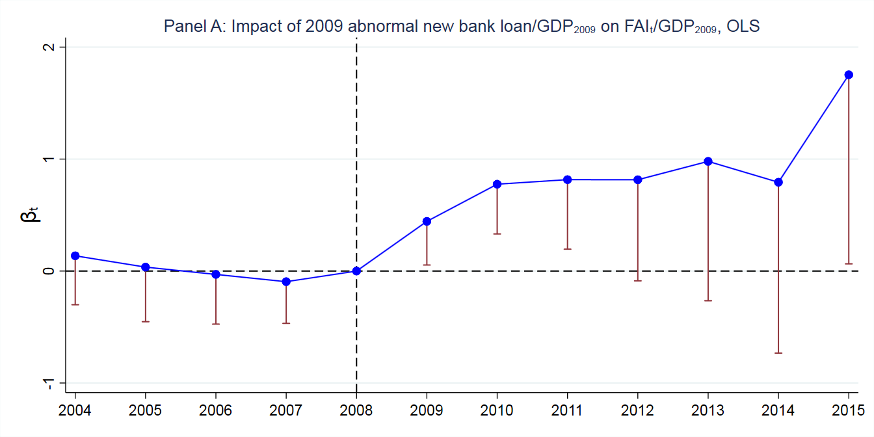
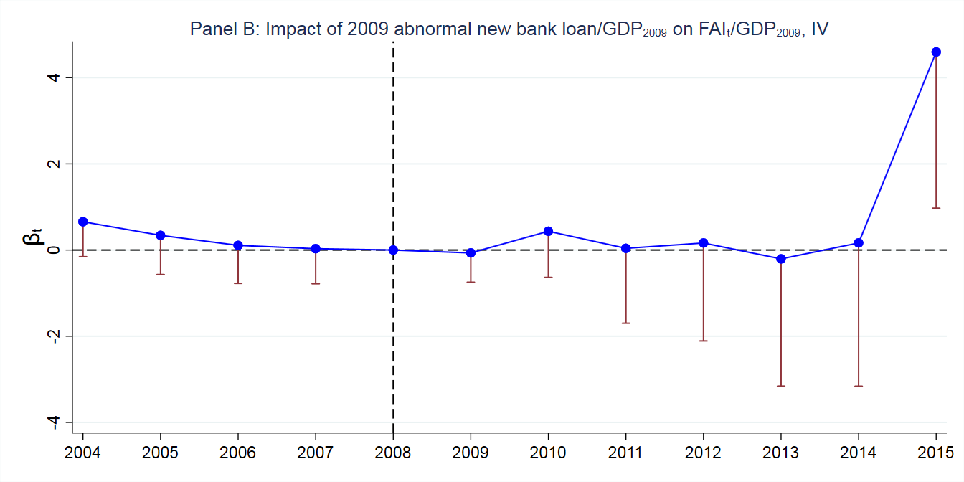
REAL effects: investment

Slide 25
Link to Shadow banking

Slide 26
Link to Shadow banking: entrusted LOAN growth
Entrusted Loan/GDP_2009 on 2009 Abnormal Bank Loan/GDP
 | 2013 EL/GDP_2009 |  |  | 2014 EL/GDP_2009 |  |  | 2015 EL/GDP_2009
 | OLS | 2SLS |  | OLS | 2SLS |  | OLS | 2SLS
2009 BL/GDP | 0.294* | 0.473 |  | 0.468*** | 0.363 |  | -0.0756 | 0.326
 | (1.876) | (1.436) |  | (2.953) | (0.697) |  | (-0.282) | (0.856)
Control | Yes | Yes |  | Yes | Yes |  | Yes | Yes
Observations | 30 | 30 |  | 30 | 30 |  | 30 | 30
Adj. R2 | 0.256 | 0.220 |  | 0.293 | 0.284 |  | 0.219 | 0.109
Unfortunately, province-level EL data are only available after 2013
In 2015, tightening regulation on Trust/Entrusted business in China
Placebo: Abnormal Bank Loan/GDP_2009 on 2009 Abnormal Bank Loan/GDP
 | 2013 Abnormal BL/GDP |  |  | 2014 Abnormal BL/GDP |  |  | 2015 Abnormal BL/GDP
 | OLS | 2SLS |  | OLS | 2SLS |  | OLS | 2SLS
2009 BL/GDP | -0.0809 | -0.338 |  | -0.152 | -0.133 |  | -0.284 | -0.851
 | (-0.400) | (-0.798) |  | (-0.626) | (-0.257) |  | (-0.655) | (-1.093)
Control | Yes | Yes |  | Yes | Yes |  | Yes | Yes
Observations | 30 | 30 |  | 30 | 30 |  | 30 | 30
Adj. R2 | 0.565 | 0.553 |  | 0.644 | 0.644 |  | 0.486 | 0.460

Slide 27
Link to Shadow banking: Wealth Management Product
Based on annual official reports on WMP; likely underestimate as unclear whether including certain financial innovation funded through WMP

Slide 28
US Experience in National banking era
China’s shadow banking in today has striking similarity with the US history
National banking era (1863-1912) in US
  Started with the passage of national banking act (1864) which ended the “free banking era”
    Tightly regulated nationally chartered banks, segmented
  Frequent banking panics, especially the 1907 panic triggered by a run on Trust companies, led to Fed as the Central Bank in US
Economic background
  Industrial revolution in the Northeast to the settlement of the West; railroad construction in US is like infrastructure in China today
  A new industry craving for financing, but national banks cannot
Regulatory arbitrage (like in China)
  States in the west started imposing less restrictive regulations, so-called state banks
  Trust companies, which are state-chartered financial institutions

Slide 29
Trust companies in US history
Trust companies according to Carosso (1970, p. 99)
Incorporated under liberal state laws, trust companies quickly extended their activities far beyond those usually associated with the services of a fiduciary institution. Beginning in the 1890s, trust companies took on most of the functions of both commercial and private banks. They accepted deposits; made loans; participated extensively in reorganizing railroads and consolidating industrial corporations; acted as trustees, underwriters, and distributors of new securities; and served as depositories of stocks, bonds, and titles ..... Very often they also owned and managed real estate.
This is essentially what China’s Trust companies do

Slide 30
What do we learn?
Neal (1971): Trust companies in US history
  Invested in new industrial securities on the asset side, and issued deposit to expand the money supply
  Helped establish a financial market to feed real economy
  Form “money trust” with other dominating commercial banks at that time
IN China, shadow banking
  Supports infrastructure, real estate, and private firms while generating a savings vehicle (WMP) for Chinese households
  Accelerates the growth of Chinese corporate bond market at an astonishing speed (Amsted and He, 2018)
  Relies on the retail network of existing banking branch system; “the shadow of banks”

Slide 31
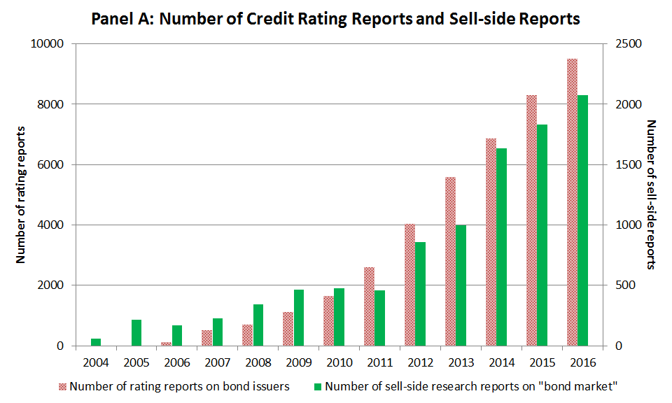
DEVELOPMENT OF CORPORATE BOND MARKETS in China

Slide 32
conclusion
A mechanism that puts together recent various aspects of China’s financial market
  Local government debt; shadow banking; interest rate liberalization
Shadow banking: unintended consequence of Four-trillion Stimulus plan
  Good? bad?
  Popular view: hidden risk and leverage, so bad
But it fosters the modernization of China’s financial markets
  “Let market be decisive;” interest rate liberalization and deposit insurance
  Rocket-speed of the growth of interbank market in China; less reliance on commercial banks; richer set of investment products
    Chen, Chen, He, Liu, and Xie (2019) on pledgeability effect
  Households get the return they ought to get (not just house price appreciation)

Slide 33
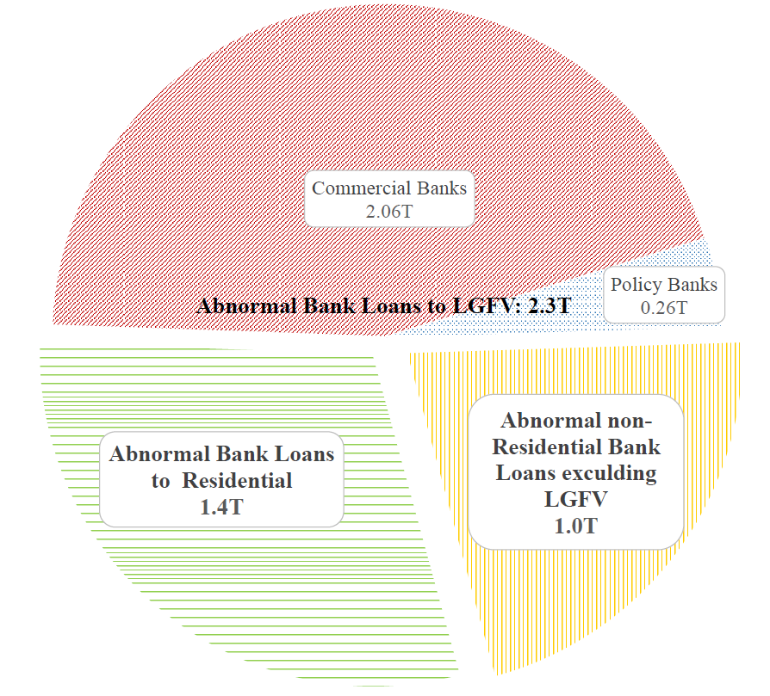
HALF OF 2009 ABNORMAL BANK LOANS GO TO LGFV
Data source: Authors’ estimate and Gao et al. (2018)

Slide 34
Panel regressions with simultaneous controls
 | MCB |  |  | MCB_repay |  |  | MCB_inv
 | OLS | 2SLS |  | OLS | 2SLS |  | OLS | 2SLS
2004 | -0.001 | -0.038 |  | 0.014 | 0.013 |  | -0.019*** | -0.045*
 | (0.026) | (0.061) |  | (0.011) | (0.019) |  | (0.006) | (0.023)
2005 | 0.024 | -0.003 |  | 0.0194* | 0.018 |  | -0.006 | -0.027
 | (0.022) | (0.053) |  | (0.010) | (0.017) |  | (0.007) | (0.021)
2006 | 0.008 | -0.014 |  | 0.014 | 0.012 |  | -0.013** | -0.029**
 | (0.019) | (0.039) |  | (0.009) | (0.012) |  | (0.005) | (0.015)
2007 | 0.004 | -0.005 |  | 0.006 | 0.007 |  | -0.005 | -0.014
 | (0.016) | (0.039) |  | (0.007) | (0.011) |  | (0.008) | (0.018)
2009 | -0.006 | -0.002 |  | -0.008 | -0.008 |  | 0.001 | -0.007
 | (0.025) | (0.060) |  | (0.009) | (0.019) |  | (0.013) | (0.027)
2010 | -0.039 | -0.014 |  | -0.019 | -0.023 |  | -0.011 | 0.004
 | (0.053) | (0.098) |  | (0.022) | (0.041) |  | (0.020) | (0.038)
2011 | 0.012 | 0.040 |  | -0.005 | 0.002 |  | 0.003 | -0.009
 | (0.066) | (0.126) |  | (0.030) | (0.056) |  | (0.019) | (0.039)
2012 | 0.112 | 0.284 |  | 0.032 | 0.076 |  | -0.013 | 0.014
 | (0.097) | (0.177) |  | (0.027) | (0.064) |  | (0.033) | (0.056)
2013 | 0.187** | 0.191* |  | 0.089*** | 0.123** |  | 0.047** | 0.019
 | (0.078) | (0.104) |  | (0.031) | (0.059) |  | (0.021) | (0.034)
2014 | 0.359*** | 0.454*** |  | 0.143*** | 0.213*** |  | 0.048 | 0.133**
 | (0.101) | (0.137) |  | (0.040) | (0.075) |  | (0.032) | (0.057)
2015 | 0.252** | 0.269 |  | 0.134*** | 0.139** |  | -0.013 | 0.044
 | (0.128) | (0.169) |  | (0.052) | (0.060) |  | (0.031) | (0.043)
Province FE | Yes | Yes |  | Yes | Yes |  | Yes | Yes
Year FE | Yes | Yes |  | Yes | Yes |  | Yes | Yes
Control | Yes | Yes |  | Yes | Yes |  | Yes | Yes
Observations | 360 | 360 |  | 360 | 360 |  | 360 | 360
Adj R2 | 0.743 | 0.721 |  | 0.660 | 0.635 |  | 0.673 | 0.680

Slide 35
EVIDENCE FROM CDB LOAN
CDB is a policy bank and thus usually its loan has longer maturity
Less rollover pressure for provinces with more CDB LGFV loan received in 2009
 | MCB |  |  | MCB_repay |  |  | MCB_inv
 | OLS | 2SLS |  | OLS | 2SLS |  | OLS | 2SLS
Low CDB*2004 | -0.002 | 0.007 |  | -0.001 | -0.001 |  | -0.002 | 0.007
 | (0.015) | (0.069) |  | (0.006) | (0.020) |  | (0.011) | (0.035)
Low CDB*2005 | -0.002 | 0.008 |  | -0.001 | -0.001 |  | -0.002 | 0.009
 | (0.016) | (0.069) |  | (0.006) | (0.020) |  | (0.011) | (0.035)
Low CDB*2006 | -0.003 | 0.007 |  | -0.001 | -0.001 |  | -0.003 | 0.007
 | (0.016) | (0.069) |  | (0.006) | (0.020) |  | (0.011) | (0.034)
Low CDB*2007 | 0.002 | 0.005 |  | -0.001 | -0.001 |  | 0.005 | 0.011
 | (0.016) | (0.072) |  | (0.006) | (0.020) |  | (0.011) | (0.034)
Low CDB*2009 | 0.086*** | 0.128*** |  | 0.008 | 0.010 |  | 0.065*** | 0.101**
 | (0.017) | (0.032) |  | (0.006) | (0.016) |  | (0.015) | (0.034)
Low CDB*2010 | 0.099*** | 0.204*** |  | 0.020*** | 0.025 |  | 0.061*** | 0.150***
 | (0.024) | (0.045) |  | (0.007) | (0.018) |  | (0.018) | (0.039)
Low CDB*2011 | 0.118*** | 0.224*** |  | 0.028*** | 0.058*** |  | 0.060*** | 0.080**
 | (0.033) | (0.058) |  | (0.007) | (0.016) |  | (0.018) | (0.036)
Low CDB*2012 | 0.408*** | 0.255 |  | 0.090 | -0.067 |  | 0.216*** | 0.150
 | (0.142) | (0.382) |  | (0.064) | (0.156) |  | (0.075) | (0.145)
Low CDB*2013 | 0.639*** | 0.612 |  | 0.180*** | 0.082 |  | 0.274*** | 0.205
 | (0.146) | (0.380) |  | (0.066) | (0.155) |  | (0.073) | (0.139)
Low CDB*2014 | 0.858*** | 1.064** |  | 0.225*** | 0.175 |  | 0.256*** | 0.251
 | (0.156) | (0.456) |  | (0.074) | (0.182) |  | (0.078) | (0.157)
Low CDB*2015 | 0.994*** | 1.326*** |  | 0.382*** | 0.503*** |  | 0.212*** | 0.134
 | (0.154) | (0.463) |  | (0.069) | (0.172) |  | (0.071) | (0.146)
2004-2007 | -0.004 | -0.003 |  | 0.000 | -0.001 |  | -0.004 | -0.003
 | (0.013) | (0.079) |  | (0.005) | (0.024) |  | (0.011) | (0.035)
2009-2011 | -0.024 | -0.038 |  | -0.005 | -0.005 |  | -0.014 | -0.031
 | (0.016) | (0.034) |  | (0.005) | (0.017) |  | (0.015) | (0.039)
2012-2015 | -0.281** | -0.154 |  | -0.065 | 0.085 |  | -0.146* | -0.022
 | (0.138) | (0.454) |  | (0.063) | (0.191) |  | (0.075) | (0.143)
Low CDB*Year | Yes | Yes |  | Yes | Yes |  | Yes | Yes
Province FE | Yes | Yes |  | Yes | Yes |  | Yes | Yes
Year FE | Yes | Yes |  | Yes | Yes |  | Yes | Yes
Control*Year | Yes | Yes |  | Yes | Yes |  | Yes | Yes
Observations | 360 | 360 |  | 360 | 360 |  | 360 | 360
Adj R2 | 0.810 | 0.725 |  | 0.730 | 0.664 |  | 0.711 | 0.655

Slide 36
REAL effects OF STIMULUS LOANS
 | GDP per capita/GDP per capita_2009 |  |  | FAI/GDP_2009
 | OLS | 2SLS |  | OLS | 2SLS
2004 | 0.087 | 0.83*** |  | 0.136 | 0.657
 | (0.169) | (0.195) |  | (0.223) | (0.414)
2005 | -0.015 | 0.357* |  | 0.035 | 0.341
 | (0.169) | (0.208) |  | (0.249) | (0.464)
2006 | -0.049 | 0.200 |  | -0.030 | 0.108
 | (0.191) | (0.204) |  | (0.226) | (0.448)
2007 | -0.007 | 0.345 |  | -0.095 | 0.031
 | (0.108) | (0.246) |  | (0.190) | (0.415)
2009 | -0.088 | 0.454*** |  | 0.444** | -0.067
 | (0.057) | (0.101) |  | (0.199) | (0.347)
2010 | 0.108 | 0.599*** |  | 0.776*** | 0.437
 | (0.081) | (0.210) |  | (0.227) | (0.546)
2011 | 0.346*** | 0.938** |  | 0.817*** | 0.040
 | (0.135) | (0.435) |  | (0.317) | (0.886)
2012 | 0.394 | 1.67** |  | 0.815* | 0.164
 | (0.280) | (0.722) |  | (0.460) | (1.155)
2013 | 0.393 | 2.725** |  | 0.980 | -0.205
 | (0.440) | (1.208) |  | (0.635) | (1.507)
2014 | 0.379 | 3.892** |  | 0.793 | 0.166
 | (0.624) | (1.716) |  | (0.778) | (1.701)
2015 | 0.397 | 5.169*** |  | 1.753** | 4.596**
 | (0.724) | (1.934) |  | (0.862) | (1.849)
Province FE | Yes | Yes |  | Yes | Yes
Year FE | Yes | Yes |  | Yes | Yes
Control*Year | Yes | Yes |  | Yes | Yes
Observations | 360 | 360 |  | 360 | 360
Adj R2 | 0.979 | 0.982 |  | 0.970 | 0.970
FAI: fixed asset investment

